Slide 1
Chapter 3 Logic Gates
逻辑门

Slide 2

The Inverter 反相器 (也称非门)
The inverter performs the Boolean NOT operation, the Boolean expression for an inverter is
$x=\overline{A}$ or x=A’
Truth table
Input | Output
A | X
0 | 1
1 | 0

Slide 3
The Inverter 反相器 (也称非门)
The negation and polarity indicators.
否定和极性指示
Active high
Active low
Active low
Active high

Slide 4
The inverter
Example waveforms:
A
X
A group of inverters can be used to form the 1’s complement of a binary number:
Binary number
1 0 0 0 1 1 0 1
0 1 1 1 0 0 1 0

Slide 5
The AND Gate 与门
An AND gate produces a HIGH output only when all of the inputs are HIGH.
The AND operation:
X = A·B X = AB
X=A*B X=A∧B
Truth table
Input |  | Output
A | B | X
0 | 0 | 0
0 | 1 | 0
1 | 0 | 0
1 | 1 | 1

Slide 6
The AND Gate
Tow or more inputs.
One single output.

Slide 7
The AND Gate
Example waveforms:
A
B
X
An AND gate produces a HIGH output only when all of the inputs are HIGH.

Slide 8
The AND Gate
The AND operation is used in computer programming as a selective mask. If you want to retain certain bits of a binary number but reset the other bits to 0, you could set a mask with 1’s in the position of the retained bits.
Example: If the binary number 10100011 is ANDed with the mask 00001111, what is the result?
00000011

Slide 9
The OR Gate 或门
The OR gate produces a HIGH output if any input is HIGH.
The OR operation:
X=A+B X=A∨B
Truth table
Input |  | Output
A | B | X
0 | 0 | 0
0 | 1 | 1
1 | 0 | 1
1 | 1 | 1

Slide 10
The OR Gate 或门
Tow or more inputs.
One single output.

Slide 11
The OR Gate
Example waveforms:
A
B
X
The OR gate produces a HIGH output if any input is HIGH; if all inputs are LOW, the output is LOW.

Slide 12
The OR Gate
The OR operation can be used in computer programming to set certain bits of a binary number to 1.
Example: ASCII letters have a 1 in the bit 5 position for lower case letters and a 0 in this position for capitals. (Bit positions are numbered from right to left starting with 0.) What will be the result if you OR an ASCII letter with the 8-bit mask 00100000?
The resulting letter will be lower case (e.g. a=0x61 A=0x41).

Slide 13

The NAND Gate 与非门
The NAND (NOT AND) operation: $X=\overline{AB}$
The NAND gate produces a LOW output when all inputs are HIGH; otherwise, the output is HIGH.
Truth table
Input |  | Output
A | B | X
0 | 0 | 1
0 | 1 | 1
1 | 0 | 1
1 | 1 | 0

Slide 14
The NAND Gate 与非门
Tow or more inputs.
One single output.

Slide 15
The NAND Gate
Example waveforms:
A
B
X
The NAND gate produces a LOW output when all inputs are HIGH; otherwise, the output is HIGH.

Slide 16
The NAND Gate
The NAND gate is particularly useful because it is a “universal” gate – all other basic gates can be constructed from NAND gates.
Question: How would you connect a 2-input NAND gate to form a basic inverter?

Slide 17

The NOR Gate 或非门
Tow or more inputs.
One single output.
The NOR (NOT OR) operation: $X=\overline{A+B}$
Truth table
Input |  | Output
A | B | X
0 | 0 | 1
0 | 1 | 0
1 | 0 | 0
1 | 1 | 0

Slide 18
The NOR Gate
Example waveforms:
A
B
X
The NOR gate produces a LOW output if any input is HIGH; if all inputs are HIGH, the output is LOW.

Slide 19
The NOR Gate
Example: When is the LED is ON for the circuit shown?
The LED will be on when any of the four inputs are HIGH.

Slide 20
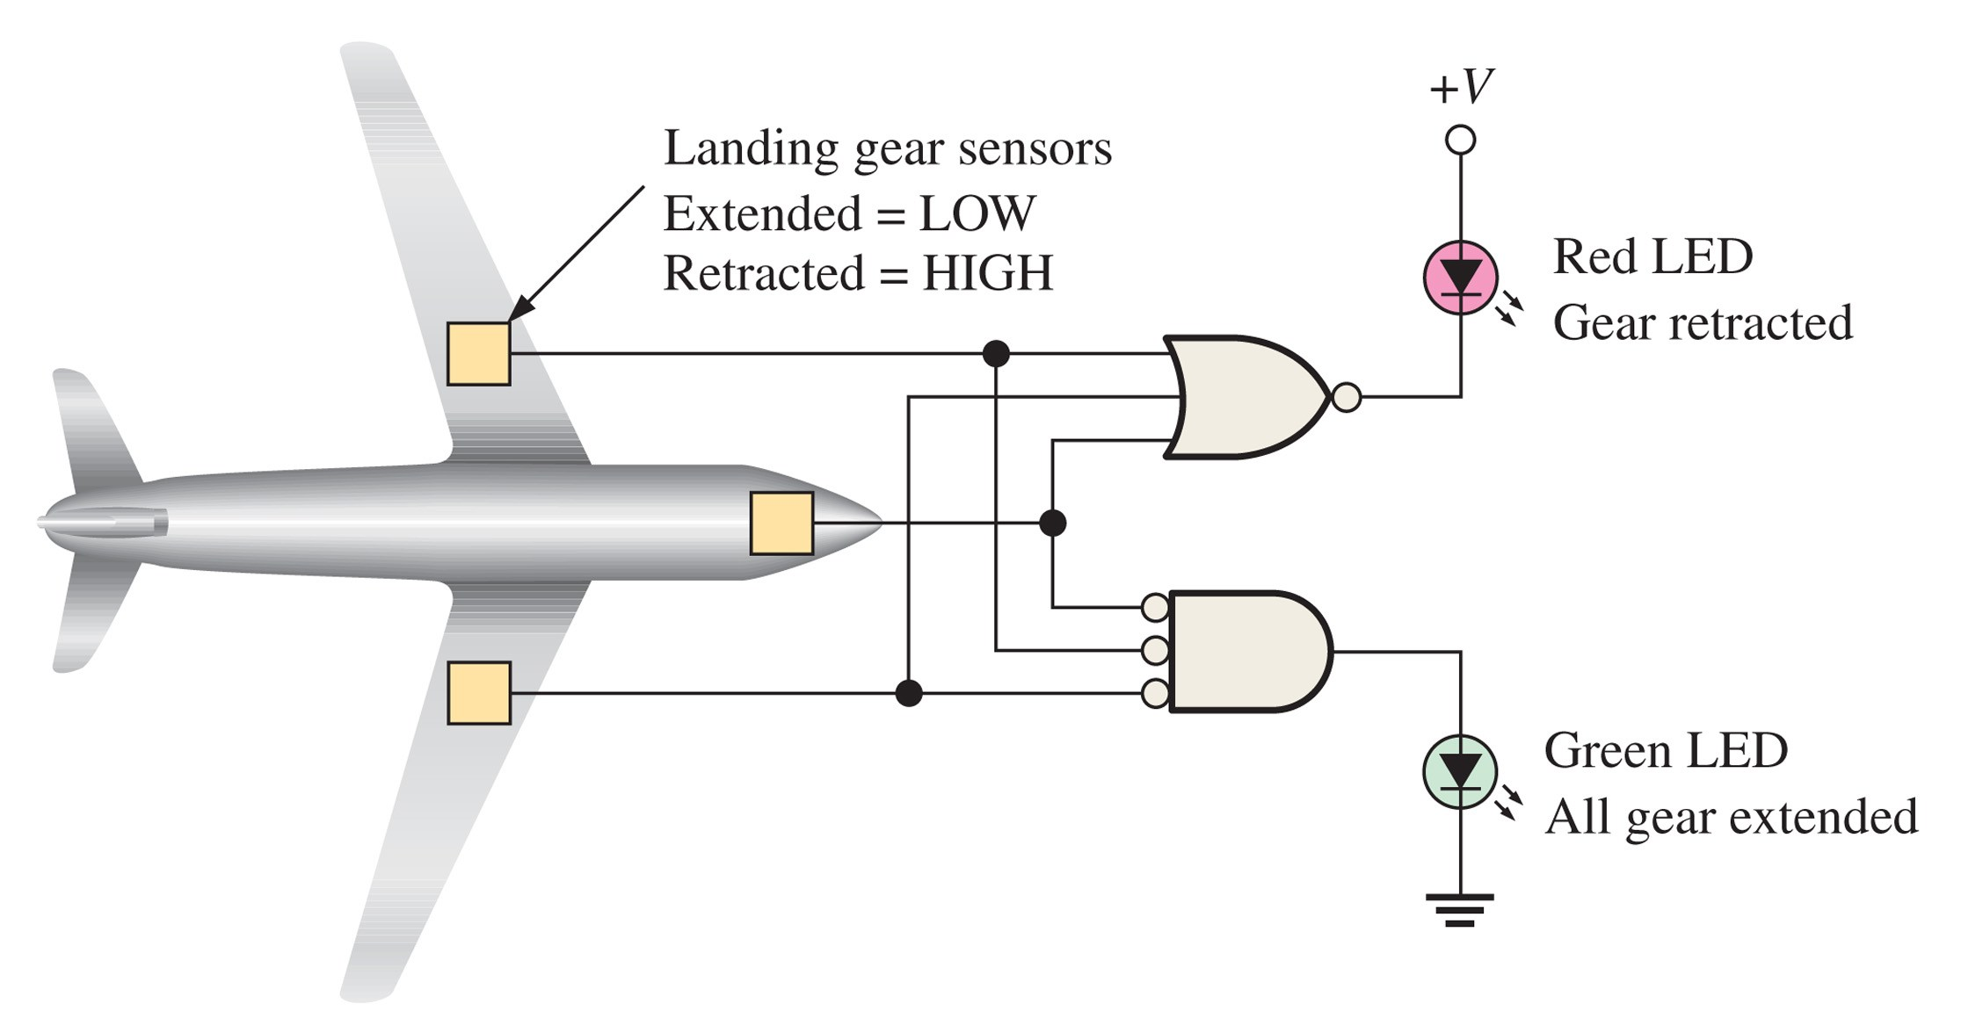

Slide 21

The XOR Gate 异或门(EX-OR)
The XOR (exclusive or ) operation: $X=\overline{A}B+A\overline{B}$
$X=A⊕B$
Truth table
Input |  | Output
A | B | X
0 | 0 | 0
0 | 1 | 1
1 | 0 | 1
1 | 1 | 0

Slide 22
The XOR Gate
Example waveforms:
A
B
X
Notice that the XOR gate will produce a HIGH only when exactly one input is HIGH.
Question: If the A and B waveforms are both inverted for the above waveforms, how is the output affected?
There is no change in the output.

Slide 23

The XnOR Gate 同或门(EX-NOR)
The XNOR (exclusive not or ) operation: $X=\overline{A}\overline{B}+AB$
$X=\overline{A⊕B}$ or $X=A⊙B$
Truth table
Input |  | Output
A | B | X
0 | 0 | 1
0 | 1 | 0
1 | 0 | 0
1 | 1 | 1

Slide 24
The XNOR Gate
Example waveforms:
A
B
X
Notice that the XNOR gate will produce a HIGH when both inputs are the same. This makes it useful for comparison functions.
Question: If the A waveform is inverted but B remains the same, how is the output affected?
The output will be inverted.

Slide 25
IEEE Logic Symbols
Function
表示功能的名字或符号
Input variables
输入变量
Output variables
输出变量

Slide 26
IEEE Logic Symbols
X
&
Z
X
+
Z
X
Z
>=1
Y
Y
Y
Z=XY
Z=X+Y
X
X
X
X

Slide 27




IEEE Logic Symbols
X
&
Z
X
+
Z
Y
Y
$$Z=\overline{XY}$$
$$Z=\overline{X+Y}$$
X
=1
Z
X
=1
Z
Y
Y
$$Z=X⊕Y$$
$$Z=X⊙Y$$

Slide 28
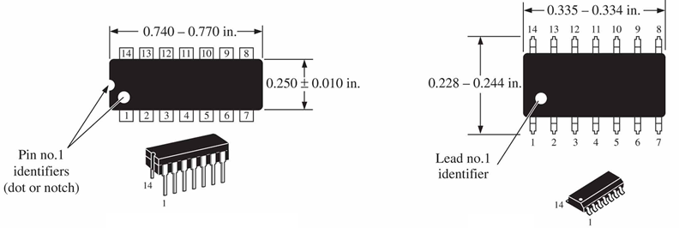
Fixed Function Logic* 固定功能逻辑
Two major fixed function logic families are TTL （双极型）and CMOS（互补金属氧化物半导体）. A third technology is BiCMOS（双CMOS）, which combines the first two. Packaging for fixed function logic is shown.
DIP package
双引线封装
SOIC package
小轮廓集成电路封装

Slide 29
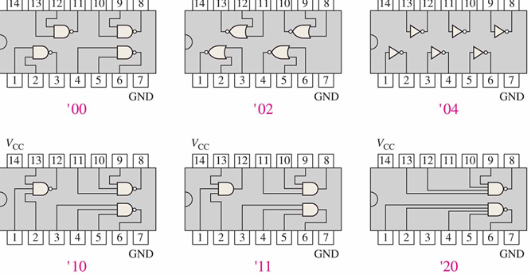
Fixed Function Logic*
00: 4 NAND gates
02: 4 NOR gates
04: 16 INVERTERs
……

Slide 30
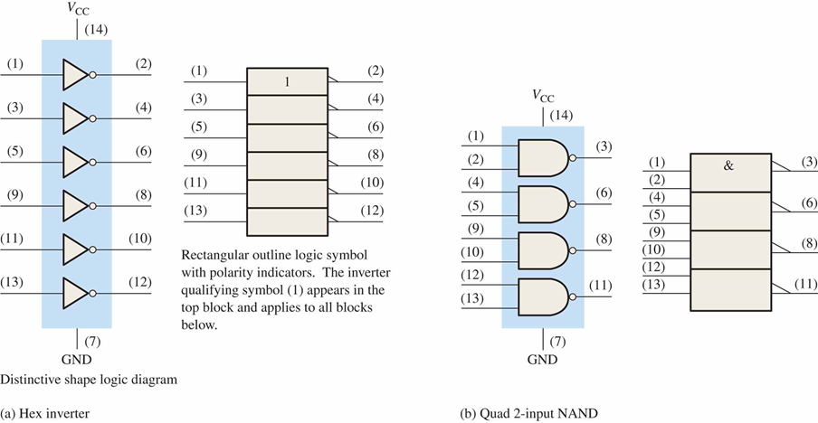
Fixed Function Logic*
Logic symbols show the gates and associated pin numbers

Slide 31
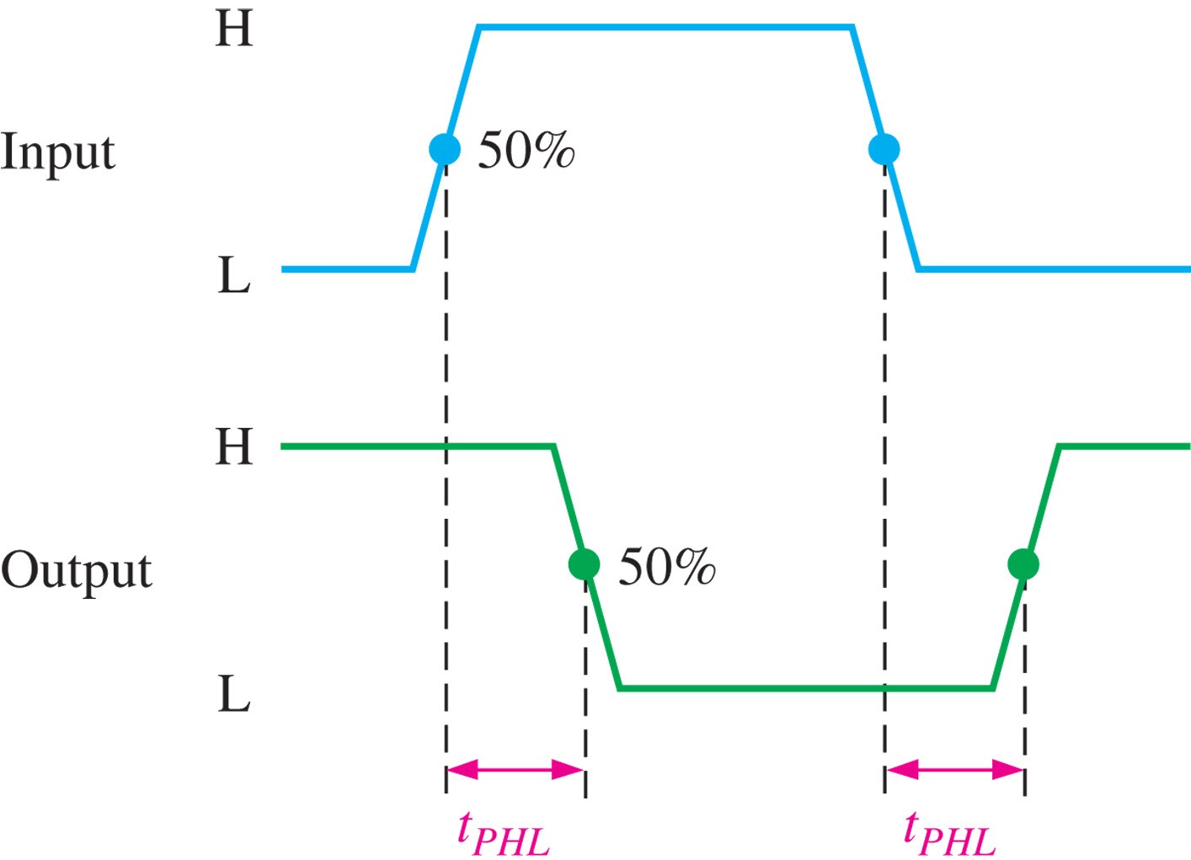
Fixed Function Logic*
Data sheets include limits and conditions set by the manufacturer .

Slide 32
Fixed Function Logic*
商用先进低功耗肖特基“与非”门集成电路
SN74ALS00
低功耗（L）
高速（H）
低功耗肖特基 (LS)
肖特基 (S)
先进低功耗肖特基 (ALS)
先进肖特基 (AS)
生产者
德州仪器公司
54--- 军用温度范围(-55℃~125℃)
74--- 商用温度范围(0℃ ~70℃)

Slide 33
Handling Precautions for CMOS* (Page 85)
CMOS逻辑芯片对静电非常敏感，如果操作不当，CMOS会由于静电放电（ESD）而损坏，如下为注意事项：
保存和安放在导电泡沫上
把仪器和地连接上
手腕串联一个大电阻和地连接
在电源没有关上时，不要把芯片拔掉
电源关上时，不要加信号电压

